Slide 1

Bank Account System
Object-Oriented Programming using C++
REVIEW -2
Presentation Outline
PRESENTED BY
CH.LAKSHMI NARASIMHA (25B11AI231)
K.LALITHENDRA(25B11AI558)
T.ARAVINDH (25B11AIB92)
N.JOGI VENKATA SWAMY(26B11AI077)
II YEAR-3rd Semester | BATCH-1
Department of Artificial Intelligence & Machine Learning

Slide 2




Presentation Outline
Abstract
Introduction
System Analysis
Database Design / Data Storage
System Design
OOP Concepts
System Implementation
Code Implementation
Input Validation
Execution / Output Screens
11.References & Conclusion

Slide 3
Abstract
The Bank Account System is a console-based application developed using C++ and Object-Oriented Programming (OOP) concepts to simplify basic banking operations. The system allows users to create a bank account by entering an account number, customer name, and initial deposit. It provides essential functions such as deposit, withdrawal, balance enquiry, and account information management.
The system validates user inputs, including a minimum 12-digit account number, and checks the available balance before processing withdrawals. The account balance is automatically updated after every successful transaction, reducing manual calculation errors and improving efficiency.
This project demonstrates the practical application of classes, objects, encapsulation, functions, conditional statements, and input validation in C++. The system provides a simple foundation that can be further enhanced with database connectivity, authentication, transaction history, and a graphical or web-based interface.

Slide 4
PROJECT INTRODUCTION
INTRODUCTION
Presentation Outline
SYSTEM OVERVIEW
A software application designed to manage basic banking operations.
Allows users to create and manage bank accounts digitally.
Performs deposit, withdrawal, balance enquiry and account details.
Reduces manual record maintenance and paperwork.
Demonstrates core Object-Oriented Programming concepts.
User / Account Holder
Bank Account System
Banking Operations
Account Records

Slide 5
System Analysis
1. Existing System
Manual account management
Time-consuming transactions
Higher chance of calculation errors
2. Proposed System
C++ console-based banking application
Supports account creation, deposit, and withdrawal
Automatically updates account balance
3. System Requirements
C++ compiler
Basic computer system
OOP concepts and input validation
Simple and user-friendly interface

Slide 6
MODULES
Planned Modules & Functions
01
02
03
04
Account Creation
Login / Verification
Deposit
Withdrawal
Register a new account holder
Verify account number identity
Credit amount to the account
Debit amount after balance check
05
06
07
08
Balance Enquiry
Account Details
Transaction History
Account Closure
Read current stored balance
Display full account record
List of past operations
Deactivate and settle account

Slide 7
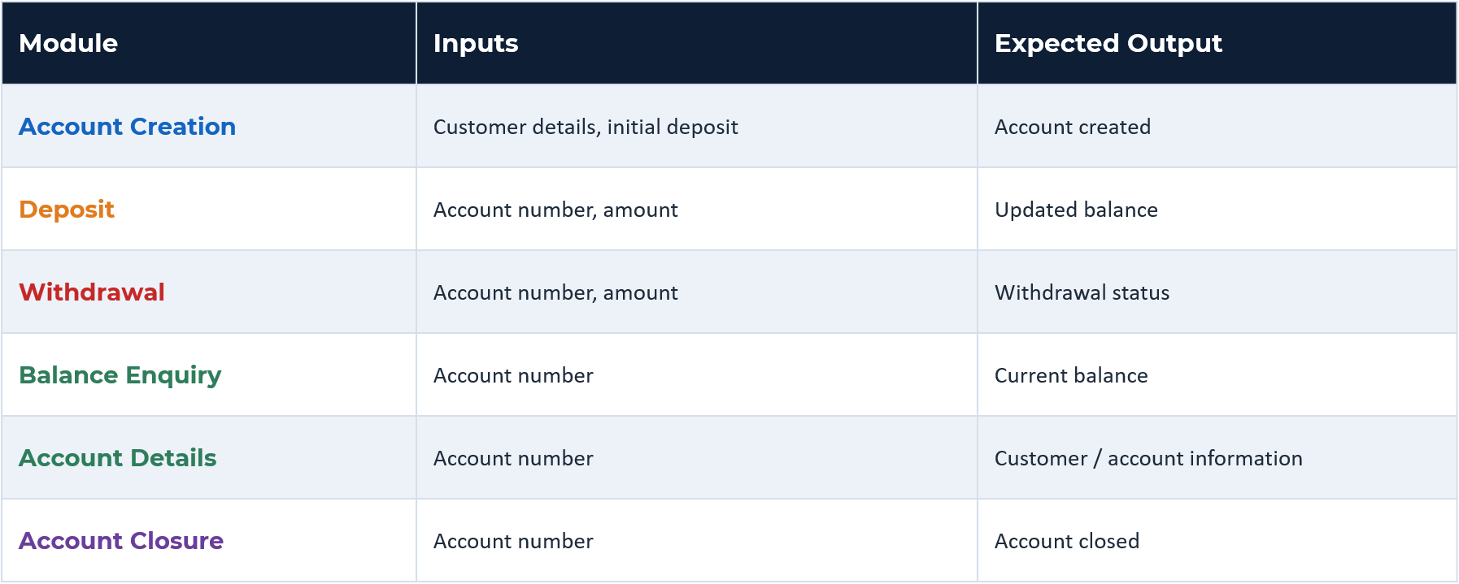
Inputs & Expected Outputs

Slide 8

Algorithms Used
Account Creation Algorithm
Deposit Algorithm
Withdrawal Algorithm
1
Read customer details
1
Search account
1
Search account
2
Validate input
2
Validate amount
2
Validate amount
3
Generate / store account info
3
Add amount to balance
3
Check available balance
4
Set initial balance
4
Update account record
4
Deduct amount if sufficient
5
Display confirmation
5
Display new balance
5
Display transaction result

Slide 9
Database Design & Data Storage
1. Data Design
BankAccount class represents an account.
Stores Account Number, Customer Name, and Balance.
Account number is validated to contain at least 12 digits.
2. Data Storage
Account details are stored temporarily in C++ class/object variables during program execution.
Deposit and withdrawal operations update the balance.
No permanent database is currently connected.
3. Future Database Design
A database such as MySQL can be added in the future.
An Accounts table can store customer and account details.
A separate Transactions table can store deposits and withdrawals.

Slide 10

System Design
START
OPERATIONS
Account Creation
Display Menu
Deposit
Select Operation
Withdrawal
Validate Input
Balance Enquiry
Perform Operation
Account Details
Display Result
Return to Menu?
YES
NO
END

Slide 11
OOP Concepts
OOP Concept | Implementation in Project | Purpose
Class | BankAccount | Defines account data and functions
Object | BankAccount account; | Represents a bank account
Encapsulation | private data members | Protects account information
Abstraction | createAccount(), deposit(), withdraw() | Hides internal processing
Data Members | accountNumber, holderName, balance | Store account information
Member Functions | deposit(), withdraw(), currentBalance() | Perform banking operations

Slide 12
Conclusion
Conclusion
The Bank Account System provides a simple and efficient way to manage basic banking operations.
It supports account creation, deposit, withdrawal, and balance enquiry.
The project demonstrates important C++ and OOP concepts such as classes, objects, and encapsulation.
Input validation and automatic balance updates help improve accuracy and reliability.
The system can be enhanced in the future with database connectivity, authentication, transaction history, and a GUI/web interface.

Slide 13
THANK YOU

